Slide 1
Software Design
Patterns and Anti-Patterns

Slide 2
Table of Contents
Singleton
Blob
Factory
Continuous Obsolescence
Golden Hammer
Abstract Factory
Lava Flow
Observer
Ambiguous Viewpoint
Decorator
Functional Decomposition
Facade
Poltergeist
Composite
Boat Anchor
Flyweight
Cut and Paste
Chain of Responsibility
Dead End
Mediator
Spaghetti Code
State Design

Slide 3

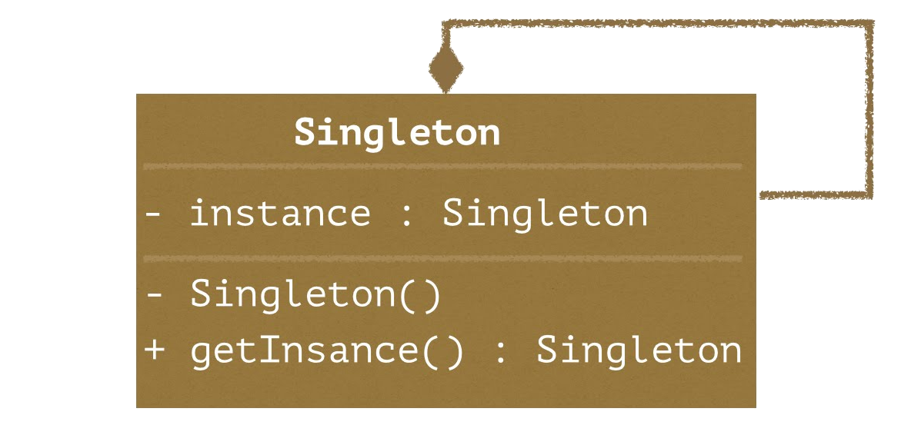
Singleton Pattern
Synopsis: Ensures a class only has one instance, and provides a global point of access to it.

Slide 4
Key points
A class is a singleton if there is to be only a single instance of that class.
The singleton class is responsible for verifying there is the only instance, often by using a static operation to instantiate the class.
If another class attempts to instantiate a second instance the singleton instead throws an error or returns a reference to the already existing instance.

Slide 5
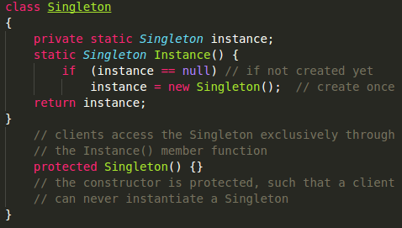
Example
Notice the instance member is static, as is the reference method.
This would be invoked as Singleton.Instance()
ensuring that an instance is always available, without the risk of creating a second instance.

Slide 6
Benefits
Controlled access to a sole instance
Reduced name space
More flexible than class operations
Refinement of operations and representation
Easy refactoring to a variable, yet still specific, number of instances.

Slide 7
Use Cases
When there must be exactly one instance of a class, but must still be accessible to clients from a well known access point. (Account services, printer queue management)
When the sole instance should be extensible through subclassing to allow clients to use an extended instance without modifying its code.
When access to the instance must be controlled. (Bank Systems, Data Systems)

Slide 8
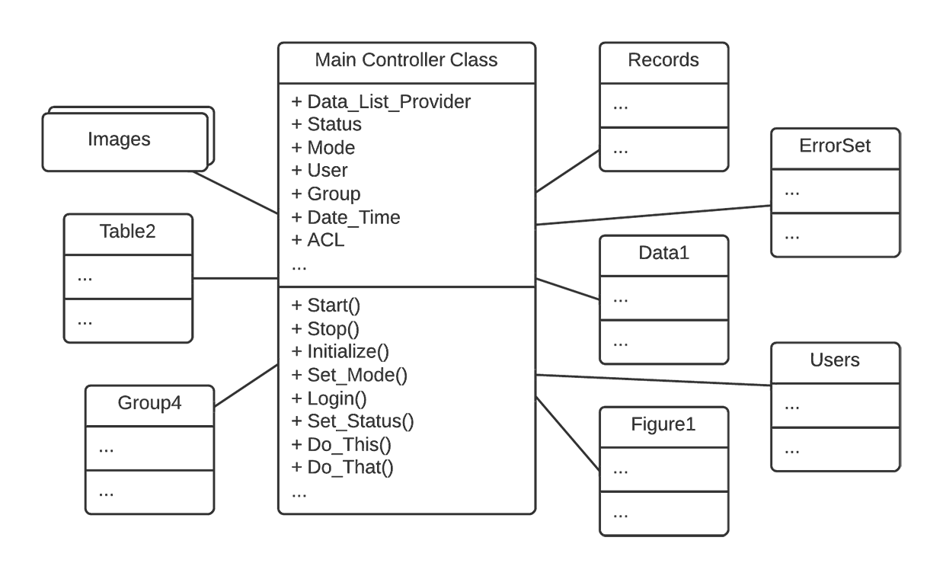
Blob Anti-Pattern
Synopsis: One object responsible for the majority of responsibilities. Most other objects exist only to hold data or execute menial tasks.

Slide 9
Key points
A single class with a large number of attributes/operations
A disparate collection of unrelated attributes and operations contained in a single class
A controller class associated only with simple data-object classes
Lack of object-oriented design, main loop inside the blob with other objects acting as procedural structs.

Slide 10
Costs
Expensive to load into memory
Not eligible for reuse
Too difficult to test properly
Small modifications to the system can affect large portions of the code base

Slide 11
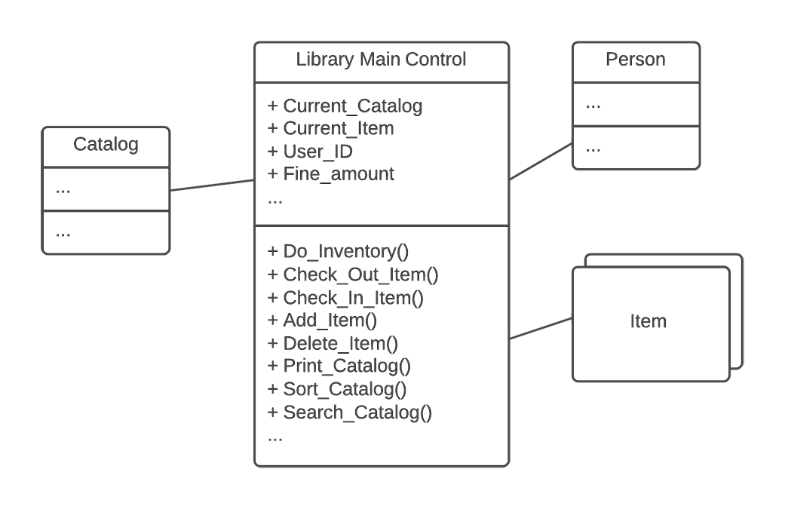
Example

Slide 12
Refactoring
Move behaviors away from the blob
Identify coherent groups of data and method
Divide responsibility among other member classes

Slide 13
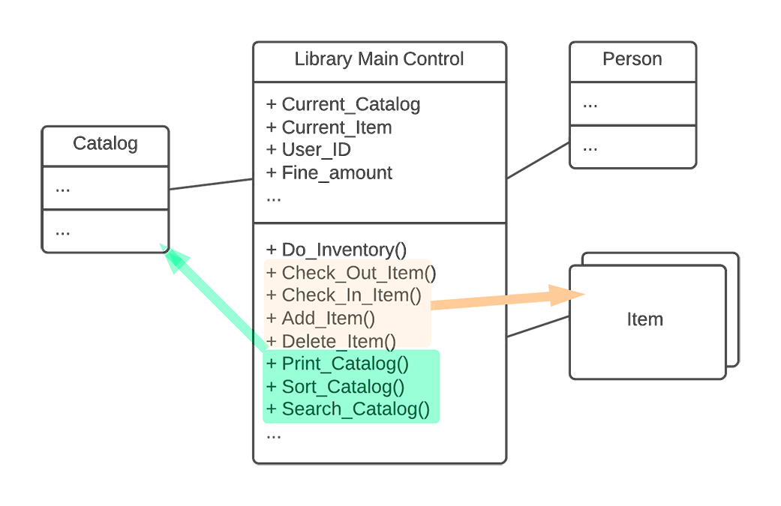
Refactored Example

Slide 14
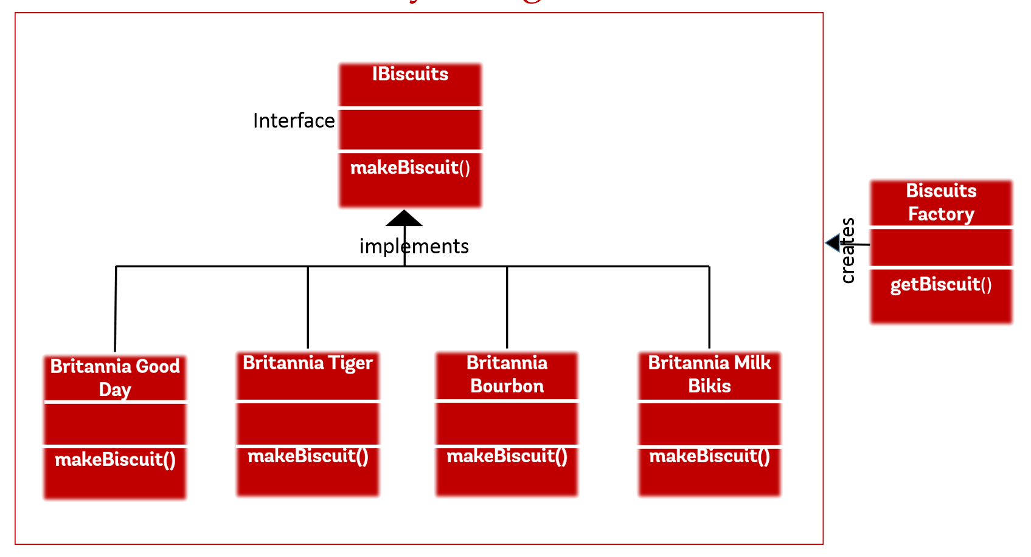
Factory Pattern
Synopsis: Subclasses implement a common interface. The factory class instantiates one of those subclasses based on input parameters.

Slide 15
Key points
Multiple concrete classes inherit from a common interface
A factory class decides based on parameters which of the concrete classes will be implemented
The objects created by the factory are related, but are differentiable
Useful when many instances of similar objects will be necessary

Slide 16
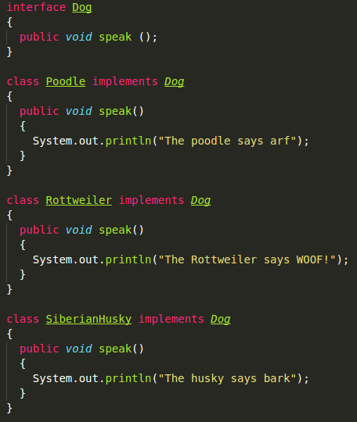
Example
Here Poodle, Rottweiler, and SiberianHusky implement the common Dog interface

Slide 17
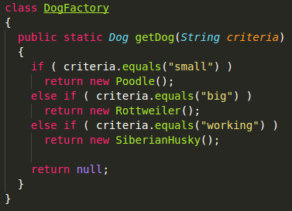
Example
Based on input parameters the DogFactory class returns a Dog.
Notice the return type is Dog, not Poodle etc.
That is because the factory will always return something that implements the Dog interface.

Slide 18
Benefits
Efficient code reuse
Simple extensibility
New subclasses can be easily added without affecting the other classes
Easy testing

Slide 19
Use Cases
When there will be many instances of similar objects that vary based on parameters (Free, Regular, Premium Members)
When simple constructors are not expressive enough
When objects have many dependencies
When access to other objects needs to be limited

Slide 20
Continuous Obsolescence Mini Anti-Pattern
Synopsis:
As the rate of releasing software development tools increases, it is difficult for some developers to keep pace. As commercial products evolve, finding compatible releases of products that successfully interoperate across versions is becoming harder.

Slide 21
Key points
Many Developer Tools companies strive to rapidly innovate and release new versions
This is because they are trying to maintain:
Marketshare: the percentage of the related market that uses the technology they produce, e.g. Windows vs Linux vs OSX
Mindshare: Dedicated attention of consumers to stay up to date with current releases

Slide 22
Costs
Difficult to maintain systems on most recent versions of used tools.
Employee time to learn how the new versions work/are different from old versions.
Code must occasionally be refactored to be compliant with newest versions.
Leads to Golden Hammer anti-pattern.

Slide 23
Golden Hammer Mini Anti-Pattern
Synopsis:
Employees grow used to the tools they use most frequently. When deciding what tools to use for a new or acquired project, employees are biased towards familiar tools. Familiar tools are used even if they are not the best option for the task.

Slide 24
Key points
Developers spend a lot of time using the same tools/systems.
When deciding on a tool or language teams and individuals are highly biased towards a few options.
Minimal time is spent exploring possible options.
When decisions are made, they are made based off familiarity and not technological superiority.

Slide 25
Costs
Systems may not be as performant as could be.
Exceptional strides are taken in order to allow the use of a favored tool, even though no empirical advantage is present.
Developers will argue for arguments that are easily satisfied by the golden hammer, and may struggle to meet other requirements.
System design and architecture are dictated by existing options instead of exploring new, potentially better ones.

Slide 26
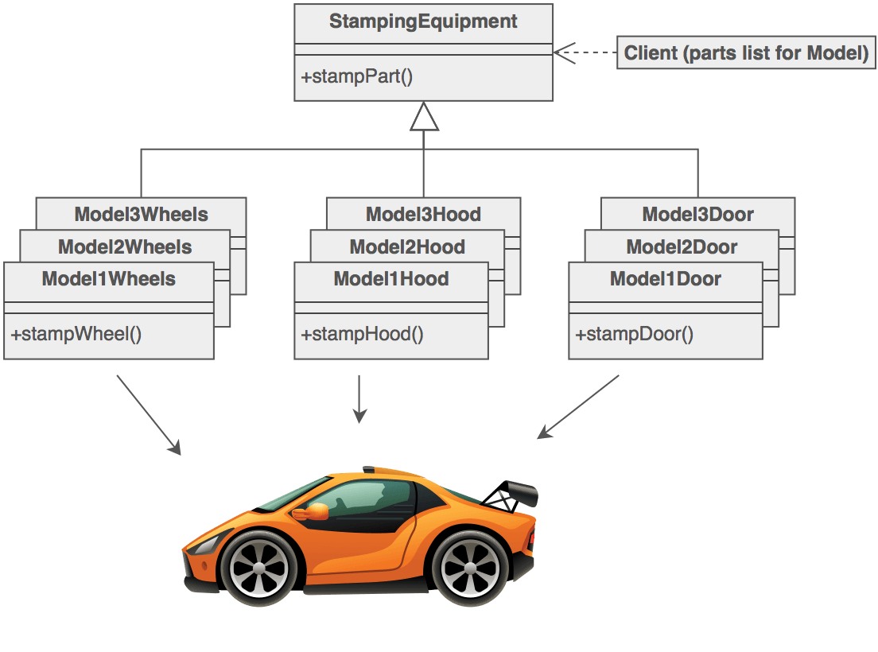
Abstract-Factory Pattern
Synopsis: Provides an interface for creating families of related products without specifying their concrete classes.

Slide 27
Key points
A hierarchy that encapsulates many possible platforms and the construction of a suite of products.
The “new” operator is considered detrimental to the system.
Clients never create platform objects directly, they ask the factory to do so.
Since the service provided by the factory is pervasive it is typically also a singleton.

Slide 28
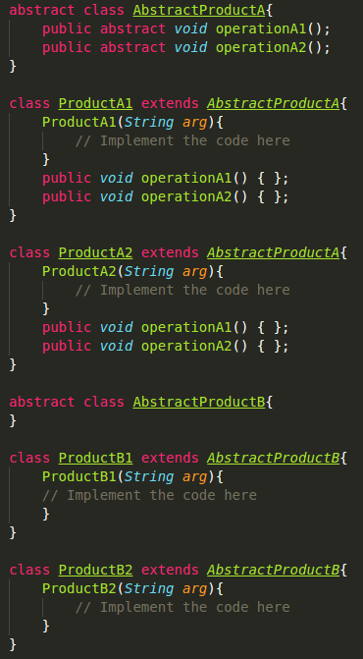
Example
Here we see that there are 2 types of abstract classes.
Each abstract class has 2 concrete classes that extend those classes.
There could easily be added more abstract classes, or more concrete classes for the existing abstract classes.

Slide 29
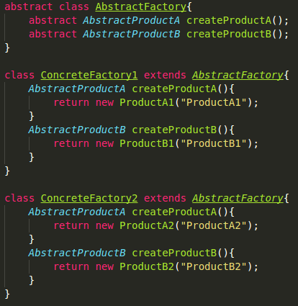
Example
An abstract factory provides abstract methods that will be used by the concrete factories which will be instantiated when needed.
The concrete factories can instantiate the concrete classes shown on the previous slide as needed.

Slide 30
Benefits
Efficient code reuse
Simple extensibility
As new concrete and abstract classes are added, they can be individually tested for stability. Added classes do not affect the stability of preexisting classes.
If existing classes are considered obsolete/not needed, they can be removed without affecting the integrity of the system.

Slide 31
Use Cases
Very similar to Factory pattern.
Best used in situations where extreme code flexibility is necessary.
When used with polymorphism code can be reused with almost no refactoring. It is therefore very useful in cases where rapid development or change are occurring.

Slide 32
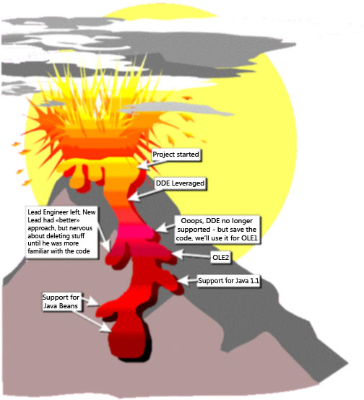
Lava Flow Anti-Pattern
Synopsis:
Dead code and forgotten design information is frozen in ever-changing code bases and design structures.
These frozen chunks of code are like lumps of rock stuck in a moving lava flow.

Slide 33
Key points
Frequent occurrence of unjustifiable variables and code fragments in the system.
Very loose “evolving” system architecture.
Lots of “To be removed” code areas.
Chunks of unreferenced code left in because people don’t want to eliminate code they didn’t write.

Slide 34
Costs
Undocumented, complex, important looking code segments are left in the system. This increases the systems load, complexity, and difficulty to understand.
Difficult to analyze, verify, and test.
Introducing new developers to the system becomes increasingly complex as understanding of the system decreases over time.

Slide 35
Causes
Shifting goals/requirements that require constant changing of existing code segments.
“Test” code, written in to verify if something can be achieved in a certain way, that is left in well after a better replacement has been implemented. This code still references relevant sections of the code base which makes removing it seem like a bad idea.
Developers that do not document changes/choices made. This makes it difficult for new developers to change/remove their segments of code, as they do not well know what other segments will be affected.

Slide 36
Refactoring
Proper refactoring can be painful. As it involves freezing progression of the project until a clear architecture can be identified for the existing system.
Potential dead code must be removed. Bugs introduced into the system must not be “quick fixed”. Dependencies must be understood and resolved so the code can follow the predetermined architecture.

Slide 37
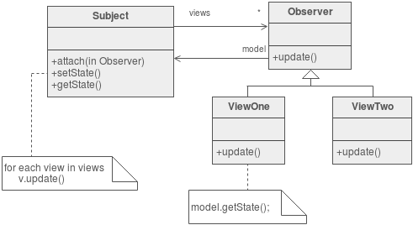
Observer Pattern
Synopsis: A one to many dependency between objects so that when one object changes state, all its dependents are notified and updated automatically.

Slide 38
Key points
Subject:
Is aware of its observers
May have any number of observers
Observer:
Defines an updating interface for objects that should be notified of changes in a given subject.
Used to maintain consistency between related objects without tightly coupling them.

Slide 39
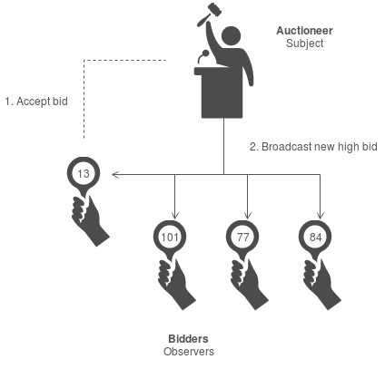
Example
In this case an the Subject (Auctioneer) broadcasts the current highest bid each time it changes.
The Observers (Bidders) are then free to do as they see fit.
If a new bid is made, the Subject then broadcasts this new bid. And again Bidders are free to do as they see fit.

Slide 40
Benefits
Abstract coupling between subject and observer
Allows notification of observers without the subject being aware of each individual observer.
Allows notification of observers without making assumptions about who/what those observers are.
Allows separate/individual reuse and variation of both the subject and the observers. (e.g. In the previous example, the Auctioneer could be allowed to receive one bid at a time or multiple)
Support for broadcast communication

Slide 41
Use Cases
Observer pattern is most useful in systems where the state of segments of the system are highly dependent on the state of a central component.
An Example:
A stock trading platform. During operating hours users can set prices and amounts for automated buying and selling. When a price changes all clients are notified and necessary actions are taken.

Slide 42
Ambiguous Viewpoint Mini Anti-Pattern
Synopsis:
Object oriented design models are often presented without clarifying the viewpoint represented by the model.
Mixed viewpoints don’t allow the fundamental separation of interfaces from implementation details.
These are the primary benefits of the object oriented paradigm.

Slide 43
Key points
There are three fundamental viewpoints for OO design models:
Business
Specification
Implementation
Failure to specify from which of these viewpoints the system is being modeled can lead to confusion and rejection of ideas and proposals.

Slide 44
Viewpoints
Business: Domain experts must be able to defend and explain these to management and potential customers. These should be the most stable models.
Specification: Focuses on software interfaces. Uses abstract data types intended to hide implementation details. These clearly show the boundaries of the system and how it interacts with users and other systems.

Slide 45
Viewpoints
Implementation: Defines the internal details of the objects. These are often called design models. These must be maintained continuously as the software is developed and modified. A developer should be able to write code that is a direct reflection of the implementation model and have it be a functioning member of the system.

Slide 46
Decorator Pattern
Synopsis: Attaches additional responsibilities to an object dynamically. Decorators provide a flexible alternative to subclassing for extending functionality.

Slide 47
Key points
Client specified embellishment of a core object by recursively wrapping it.
Adds behavior or state to individual objects at run-time.
Useful when inheritance is not feasible due to static members that apply to an entire class.

Slide 48
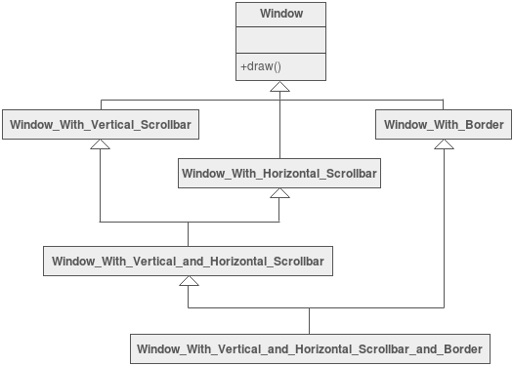
Example
This diagram is part of a diagram representing a GUI system.
Windows with varying requirements must be able to be created dynamically.
Shown here are some of the possibilities given this subset of options.
Can another possibility be identified?

Slide 49
Another Example
Many programs require the user to process input. This input can come from files or user input.
In the Java programming language “Readers” are an integral part of processing this input.
It is sometimes helpful to have a reader that reads from a file. One or more other readers are then used to process the data read by the first.
This layering of the Reader class is an example of the Decorator Design Pattern.

Slide 50
Benefits
Allows dynamic composition of static objects.
Allows addition of added members/responsibilities on the fly.
Allows existing classes to be layered in order to create new functionality.

Slide 51
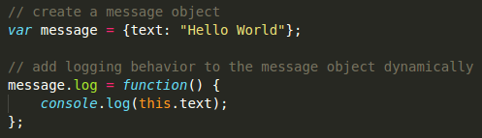
Use Cases
The decorator pattern is almost an inherent part of many design paradigms. Like in the Java example mentioned before, as well as the following JavaScript example:

Slide 52
Functional Decomposition Anti-Pattern
Synopsis:
This is the result of experienced, nonobject-oriented developers who design and implement an application in an object-oriented language. When developers are comfortable with a "main" routine that calls numerous subroutines, they may tend to make every subroutine a class, ignoring class hierarchy altogether (and pretty much ignoring object orientation entirely).

Slide 53
Key points
Classes with "function" names such as Calculate_Interest or Display_Table.
All class attributes are private and used only inside the class.
Classes with a single action such as a function.
An incredibly degenerate architecture that completely misses the point of object-oriented architecture.
Absolutely no leveraging of object-oriented principles such as inheritance and polymorphism.

Slide 54
Costs
More difficult to maintain.
Difficult/Impossible to document using OO diagrams (UML etc).
Very small chance of software reuse.
Difficult to test using standard OO testing procedures.

Slide 55
Causes
Developers who lack a background in OO development often fall into this anti-pattern.
When those in charge of creating specifications do not have a good understanding of OO principles they can create an architecture that lacks key attributes such as inheritance and polymorphism.
Lack of architecture enforcement.

Slide 56
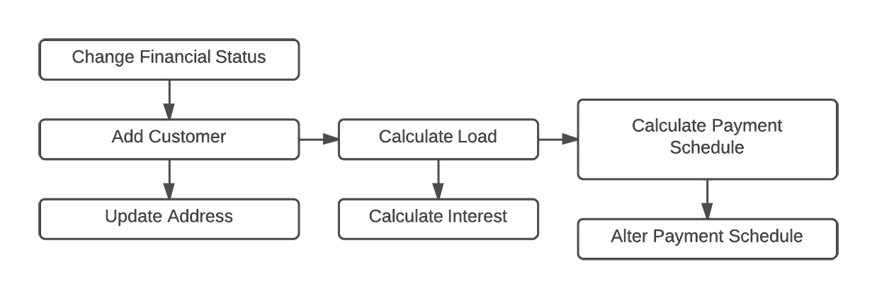
Example
Below is a diagram showing how a functionally decomposed Customer Loan system would work:

Slide 57
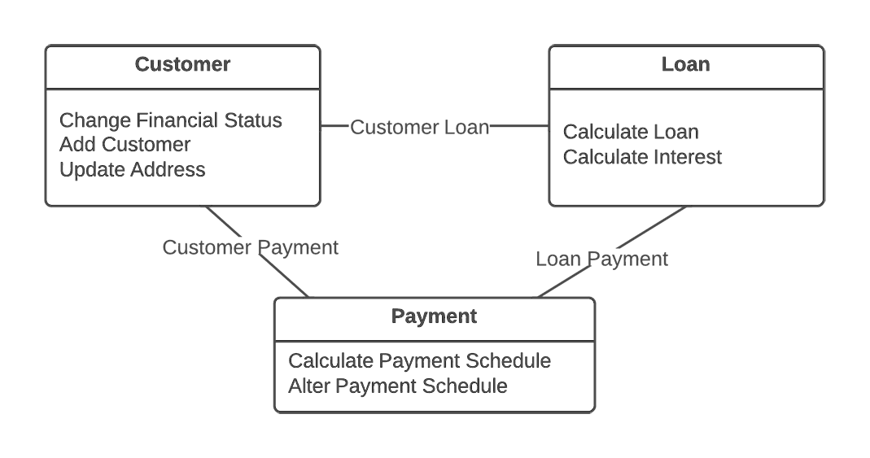
Example Refactored
Below is a diagram showing a correct OO implementation of the same system:
Notice, all the same functions are present as member methods.

Slide 58
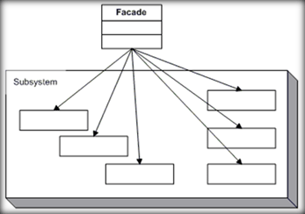
Façade Pattern
Synopsis: Provide a unified interface to a set of interfaces in a subsystem. Facade defines a higher-level interface that makes the subsystem easier to use.

Slide 59
Key points
A simple unified interface for the subsystem.
The facade captures the complexity and collaborations of the components and delegates to the appropriate methods.
Clients are exclusively interfaced with the facade.

Slide 60
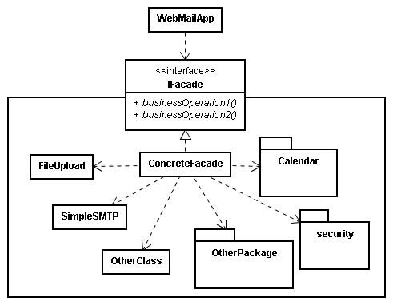
Example
In this diagram we see how the front end Web Mail App interacts with the backend infrastructure.
The App is not responsible for keeping track of all the the member classes individually.
The facade can be thought of similarly to an API for the classes it represents.

Slide 61
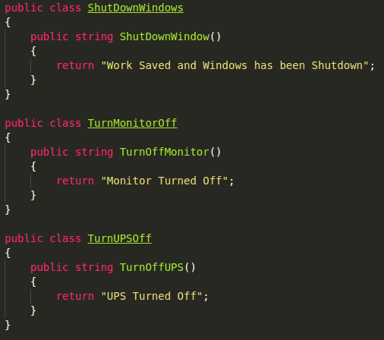
Another Example
Here are three methods representing parts of a “Shutdown Process” for a desktop.

Slide 62
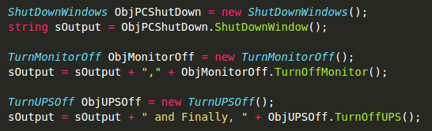
Another Example
This is what code to use all three of the previous methods to “Shut down the computer” would look like:

Slide 63
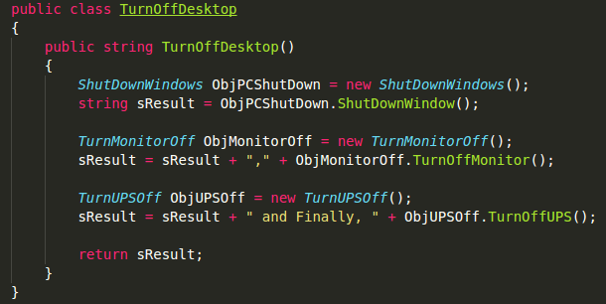
Another Example
Below is a Facade that wraps all three methods:

Slide 64
Another Example
And this is all that is necessary to use the facade to perform the same action as before:

Slide 65
Benefits
Allows other developers to more easily use portions of the system they are not familiar with.
Code brevity aids in understanding.
Allows easy refactoring of the contained classes without impacting the facades clients.
Individual classes can be tested, then the facade acts as a single target point for testing the entire contained system.

Slide 66
Poltergeist Anti-Pattern
Synopsis:
Poltergeists are classes with limited responsibilities and roles to play in the system; therefore, their effective life cycle is quite brief.
Poltergeists clutter software designs, creating unnecessary abstractions; they are excessively complex, hard to understand, and hard to maintain.

Slide 67
Key points
Poltergeists are classes that appear and disappear quickly.
They are often used to establish a state for the system and then vanish.
Sometimes they exist to perform a singular task.

Slide 68
Costs
They are unnecessary, so they waste resources every time they "appear."
They are inefficient because they utilize several redundant navigation paths.
They get in the way of proper object-oriented design by needlessly cluttering the object model.

Slide 69
Causes
Lack of understanding of OO design and architecture principles.
Incorrect tool for the job (Golden Hammer). Sometimes the object oriented approach is not the best option for the task at hand.
Specifications. When written by someone who doesn’t have a firm grasp on the objective Poltergeist classes may accidentally be worked into the system’s specifications.

Slide 70
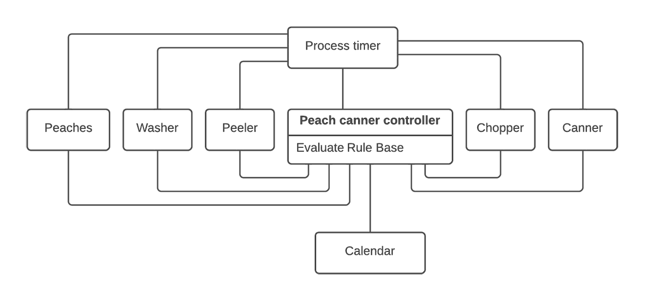
Refactoring - Problem

Slide 71
Refactoring Problem
It has redundant navigation paths to all other classes in the system.
All of its associations are transient.
It has no state.
It is a temporary, short-duration class that pops into existence only to invoke other classes through temporary associations.

Slide 72
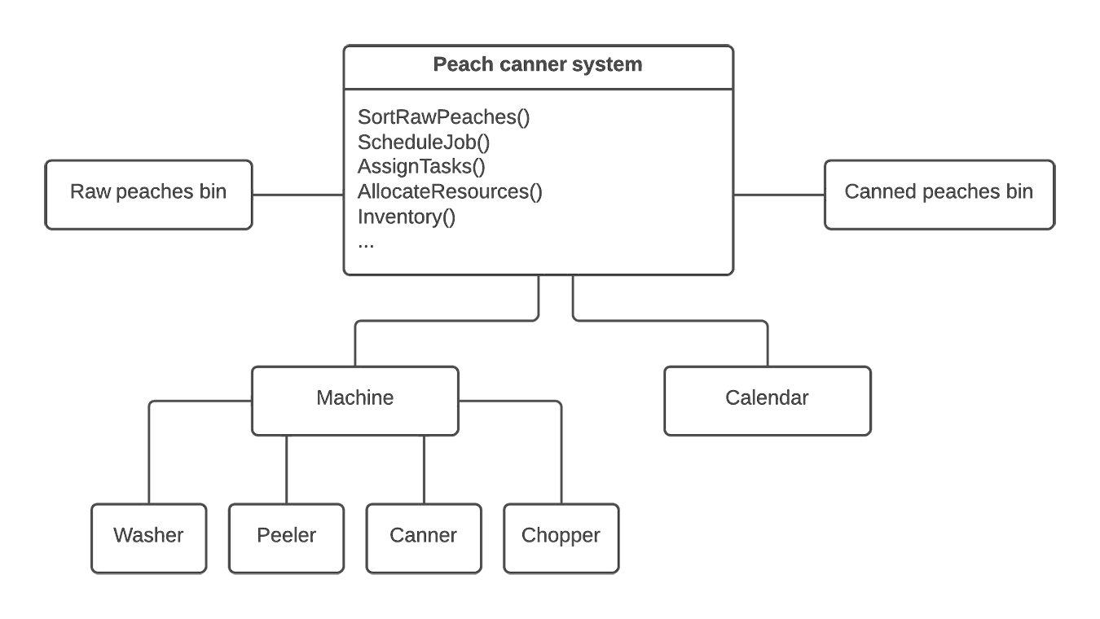
Refactoring - Fixed

Slide 73
Composite Pattern
Synopsis:
Composes objects into tree structures to represent whole-part hierarchies.
The Composite design pattern lets clients treat individual objects and compositions of objects uniformly.

Slide 74
Key points
All container and containee classes declare an "is a" relationship to the interface.
All container classes declare a one-to-many "has a" relationship to the interface.
Container classes leverage polymorphism to delegate to their containee objects.

Slide 75
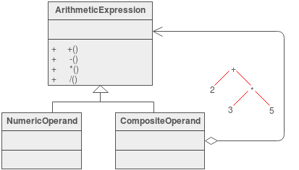
Example
The Composite composes objects into tree structures and lets clients treat individual objects and compositions uniformly.
Although the example is abstract, arithmetic expressions are Composites. An arithmetic expression consists of an operand, an operator (+ - * /), and another operand.
The operand can be a number, or another arithmetic expression. Thus, 2 + 3 and (2 + 3) + (4 * 6) are both valid expressions

Slide 76

Boat Anchor Mini Anti-Pattern
Synopsis:
A Boat Anchor is a piece of software or hardware that serves no useful purpose on the current project. Often, the Boat Anchor is a costly acquisition, which makes the purchase even more ironic.

Slide 77
Causes
A sales practice called "very important person (VIP) marketing" targets the sales pitch at senior decision makers who have buying authority. VIP marketing often focuses on chief executive officers of small- to medium-size corporations. A commitment to the product is made without proper technical evaluation.
After a significant investment of time and resources, the technical staff realizes that the product is useless in the current context, and abandons it for another technical approach. Eventually, the Boat Anchor is set aside.

Slide 78
Flyweight Pattern
Synopsis:
The Flyweight pattern describes how to share objects to allow their use at fine granularity without prohibitive cost.
Each "flyweight" object is divided into two pieces: the state-dependent (extrinsic) part, and the state-independent (intrinsic) part. Intrinsic state is stored (shared) in the Flyweight object. Extrinsic state is stored or computed by client objects, and passed to the Flyweight when its operations are invoked.

Slide 79
Key points
Flyweights are stored in a Factory's repository.
Each Flyweight cannot stand on its own. Any attributes that would make sharing impossible must be supplied by the client whenever a request is made of the Flyweight.
If the context lends itself to "economy of scale" (i.e. the client can easily compute or look-up the necessary attributes), then the Flyweight pattern offers appropriate leverage.

Slide 80
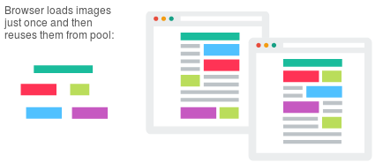
Example
Modern web browsers use this technique to prevent loading same images twice.
When browser loads a web page, it traverse through all images on that page.
The browser loads all new images from Internet and places them the internal cache.
For already loaded images, a flyweight object is created, which has some unique data like position within the page, but everything else is referenced to the cached one.

Slide 81
Benefits
Significantly reduces overhead.
Simplicity, each flyweight is only responsible for context-independent state and behavior.
Leverages the advantages of the Factory design pattern.

Slide 82
Cut-and-Paste Anti-Pattern
Synopsis:
Cut-and-Paste Programming is a very common, but degenerate form of software reuse which creates maintenance nightmares.
It comes from the notion that it's easier to modify existing software than program from scratch.
This is usually true and represents good software instincts. However, the technique can be easily over used.

Slide 83
Key points
This AntiPattern is identified by the presence of several similar segments of code interspersed throughout the software project.
Usually, the project contains many programmers who are learning how to develop software by following the examples of more experienced developers.
However, they are learning by modifying code that has been proven to work in similar situations, and potentially customizing it to support new data types or slightly customized behavior.
This creates code duplication, which may have positive short-term consequences such as boosting line count metrics, which may be used in performance evaluations.

Slide 84
Costs
The same software bug reoccurs throughout software despite many local fixes. It becomes difficult to locate and fix all instances of a particular mistake.
Developers create multiple unique fixes for bugs with no method of resolving the variations into a standard fix.
Cut-and-Paste Programming form of reuse deceptively inflates the number of lines of code developed without the expected reduction in maintenance costs associated with other forms of reuse.
Reusable assets are not converted into an easily reusable and documented form. Code is considered self documenting.
This AntiPattern leads to excessive software maintenance costs.

Slide 85
Refactoring
If performed as a single project, this refactoring process is typically difficult, long, and costly, and requires a strong system architect to oversee and execute the process and to mediate discussions on the merits and limitations of the various extended versions of software modules.

Slide 86
Refactoring
Effective refactoring to eliminate multiple versions involves three stages:
code mining
Refactoring
Configuration Management
Code mining is the systematic identification of multiple versions of the same software segment. The refactoring process involves developing a standard version of the code segment and reinserting it into the code base.

Slide 87
Refactoring
The refactoring process involves developing a standard version of the code segment and reinserting it into the code base.
Configuration management is a set of policies drawn up to aid in the prevention of future occurrences of Cut-and-Paste Programming. For the most part, this requires monitoring and detection policies, in addition to educational efforts.
Management buy-in is essential to ensure funding and support throughout all three stages.

Slide 88
Chain of Responsibility Pattern
Synopsis:
The chain of responsibility pattern avoids coupling the sender of a request to its receiver by giving more than one object a chance to handle the request.
It chains the receiving objects and passes the request along the chain until an object handles it.

Slide 89
Key points
Launch-and-leave requests with a single processing pipeline that contains many possible handlers.
An object-oriented linked list with recursive traversal.

Slide 90
Implementation
The base class maintains a "next" pointer.
Each derived class implements its contribution for handling the request.
If the request needs to be "passed on", then the derived class "calls back" to the base class, which delegates to the "next" pointer.
The client creates and links the chain (which may include a link from the last node to the root node).
The client "launches and leaves" each request with the root of the chain.

Slide 91
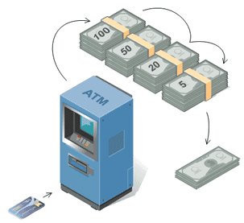
Example
Imagine an ATM that can give money using any of the available bill denominations.
The system will send a request for a specific amount of money to the dispenser.
The dispenser will send the request to the $100 bill dispenser. Once it has given what it can $50 bills are dispensed, and so on down the chain.

Slide 92
Example
Say a user requests $525, but there are no $100 bills in the machine.
The $100 bill dispenser will not accept the request and it will be passed to the $50 dispenser, which will have to dispense 10 bills instead of the 5 the $100 dispenser would have given.

Slide 93
Dead End Mini Anti-Pattern
Synopsis:
A Dead End is reached by modifying a reusable component, if the modified component is no longer maintained and supported by the supplier.
When these modifications are made, the support burden transfers to the application system developers and maintainers.
Improvements in the reusable component cannot be easily integrated, and support problems may be blamed on the modification.

Slide 94
Key Points
The supplier may be a commercial vendor, in which case this AntiPattern is also known as Commercial off-the-shelf (COTS) Customization.
The decision to modify a reusable component by a system's integrator is often seen as a workaround for the vendor's product inadequacies. As a short-term measure, this helps a product development progress, rather than slow it down.

Slide 95
Costs
The longer-term support burden becomes untenable when trying to deal with the future application versions and the "reusable component" vendor's releases.
It is necessary to use isolation layers and other techniques to separate dependencies from the majority of the application software from customizations and proprietary interfaces.

Slide 96
Mediator Pattern
Synopsis:
Defines an object that encapsulates how a set of objects interact.
The Mediator pattern promotes loose coupling by keeping objects from referring to each other explicitly, and it lets you vary their interaction independently.

Slide 97
Key points
An intermediary to decouple many peers.
Promotes the many-to-many relationships between interacting peers to "full object status".
Avoids the "spaghetti code" phenomenon (trying to scoop a single serving results in an "all or nothing clump").

Slide 98
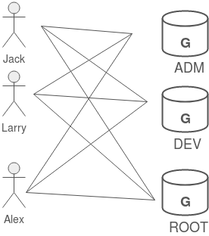
Example
In Unix, permission to access system resources is managed at three levels of granularity: world, group, and owner.
A group is a collection of users intended to model some functional affiliation.
Each user on the system can be a member of one or more groups, and each group can have zero or more users assigned to it.
This figure shows three users that are assigned to all three groups.

Slide 99
Example
If we were to model this in software, we could decide to have User objects coupled to Group objects, and Group objects coupled to User objects. Then when changes occur, both classes and all their instances would be affected.
The mediator pattern helps to avoid this.

Slide 100
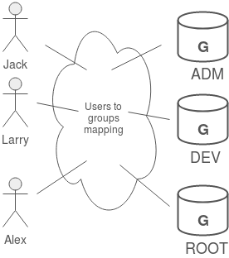
Example
An alternate approach would be to introduce "an additional level of indirection"
Take the mapping of users to groups and groups to users, and make it an abstraction unto itself.
This offers several advantages: Users and Groups are decoupled from one another, many mappings can easily be maintained and manipulated simultaneously, and the mapping abstraction can be extended in the future by defining derived classes.

Slide 101
Benefits
Partitioning a system into many objects generally enhances reusability.
Modeling the inter-relationships with an object enhances encapsulation, and allows the behavior of those inter-relationships to be modified or extended through subclassing.

Slide 102
Spaghetti Code Anti-Pattern
Synopsis:
Spaghetti Code appears as a program or system that contains very little software structure.
Coding and progressive extensions compromise the software structure to such an extent that the structure lacks clarity, even to the original developer, if he or she is away from the software for any length of time.

Slide 103
Key points
Methods are very process-oriented; frequently, in fact, objects are named as processes.
The flow of execution is dictated by object implementation, not by the clients of the objects.
Many object methods have no parameters, and utilize class or global variables for processing.
Code is difficult to reuse, and when it is, it is often through cloning. In many cases, however, code is never considered for reuse.

Slide 104
Costs
Benefits of object orientation are lost; inheritance is not used to extend the system; polymorphism is not used.
Follow-on maintenance efforts contribute to the problem.
Software quickly reaches a point of diminishing returns; the effort involved in maintaining an existing code base is greater than the cost of developing a new solution from the ground up.

Slide 105
Causes
Inexperience with object-oriented design technologies.
No mentoring in place; ineffective code reviews.
No design prior to implementation.
Frequently the result of developers working in isolation.

Slide 106
Refactoring
When the structure becomes compromised through supporting unanticipated requirements, the ability of the code to support extensions becomes limited, and eventually, nonexistent.
Well-structured code will have a longer life cycle and be better able to support changes in the business and underlying technology.

Slide 107
Refactoring
The first goal is to achieve a satisfactory structure.
The second is to determine by measurement where the performance-critical code exists.
The third is to carefully introduce necessary structure compromises to enhance performance.
It is sometimes necessary to reverse the performance enhancement changes in software to provide for essential system extensions. Such areas merit additional documentation, in order to preserve the software structure in future releases.

Slide 108
State Design Pattern
Synopsis:
Allow an object to alter its behavior when its internal state changes. The object will appear to change its class.

Slide 109
Key points
Defines a "context" class to present a single interface to the outside world.
Defines a State abstract base class.
Represents the different "states" of the state machine as derived classes of the State base class.
Defines state-specific behavior in the appropriate State derived classes.
Maintains a pointer to the current "state" in the "context" class.
To change the state of the state machine, change the current "state" pointer.

Slide 110
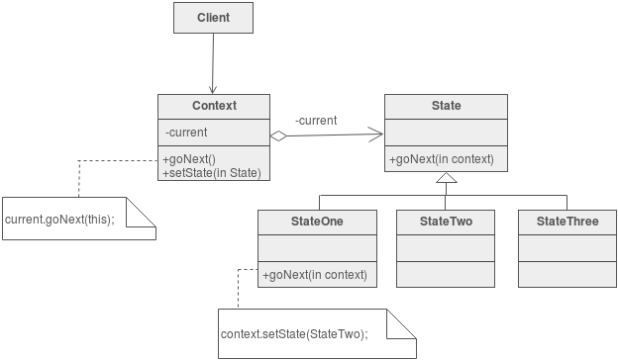
Structure

Slide 111
Structure
The state machine's interface is encapsulated in the "wrapper" class.
The wrappee hierarchy's interface mirrors the wrapper's interface with the exception of one additional parameter.
The extra parameter allows wrappee derived classes to call back to the wrapper class as necessary. Complexity that would otherwise drag down the wrapper class is neatly compartmented.

Slide 112
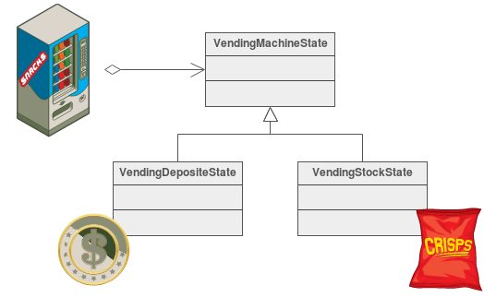
Example
The State pattern allows an object to change its behavior when its internal state changes.
This pattern can be observed in a vending machine. Vending machines have states based on the inventory, amount of currency deposited, the ability to make change, the item selected, etc.

Slide 113
Example
When currency is deposited and a selection is made, a vending machine will either deliver a product and no change, deliver a product and change, deliver no product due to insufficient currency on deposit, or deliver no product due to inventory depletion

Slide 114
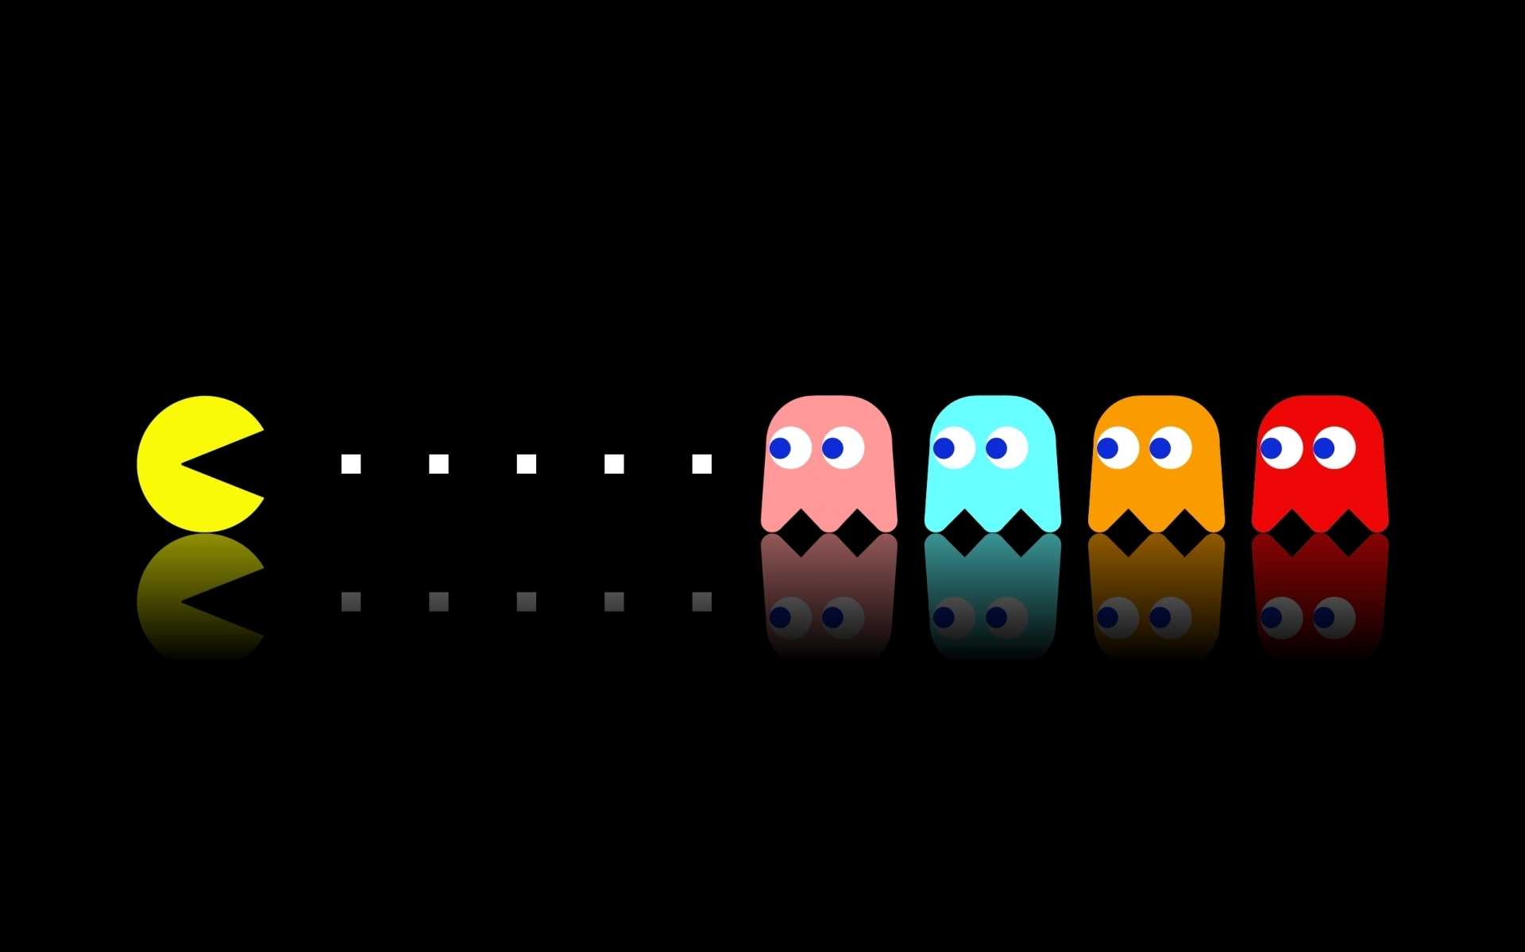
Another Example
In Pacman the ghosts have 4 different states they can be found in:
Randomly wandering
Chasing Pacman
Fleeing Pacman (after he eats the power pellet
Returning to base to regenerate.

Slide 115
Another Example
These 4 states can be handled using the State Design Pattern.
By doing so using a complicated array of conditional statements can be avoided every time a decision has to be made by the ghost.

Slide 116
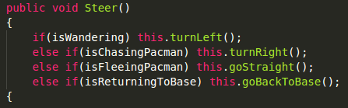
Another Example
Instead of:
Steer would simply need to execute the necessary code based on what state the ghost currently finds itself in.

Slide 117
Benefits
Avoid long chains of conditionals.
Allows modification of one state without impacting the others.
Simplifies testing based on state.

